Slide 1
Discovering Hidden Patterns in Networked Data
Keith C.C. Chan
W.W.M. Lam, A.L. Hu, T. He, P. Hu, Y. Huang
Department of Computing
The Hong Kong Polytechnic University

Slide 2
(Discovering) Learning Hidden Patterns in Networked Data
Keith C.C. Chan
W.W.M. Lam, A.L. Hu, T. He, P. Hu, Y. Huang
Department of Computing
The Hong Kong Polytechnic University

Slide 3
A History of AI
First Wave (1956-1974)
Theorem proving in geometry, solve algebra word problem, learn to speak English; Perceptron.
First Winter (1974-1980)
Too high expectation; toy problem not acceptable.
Second Wave (1980-1992)
Expert systems, connectionism, fuzzy logic, machine learning/concept learning.
Second Winter (1992-2016?)
Knowledge engineering too difficult.
Third Wave (2016-Present)
Deep Learning, Vision, Speech, NLU.

Slide 4

Discovering/Learning Hidden Patterns in Data
AI, Machine Learning and Pattern Recognition (before 1995).
Data mining (1995-2016) refers to:
the process of discovering patterns
in large data sets
involving methods at the intersection of
artificial intelligence,
machine learning,
statistics, and
database systems.
AI and Machine Learning (after 2016)

Slide 5
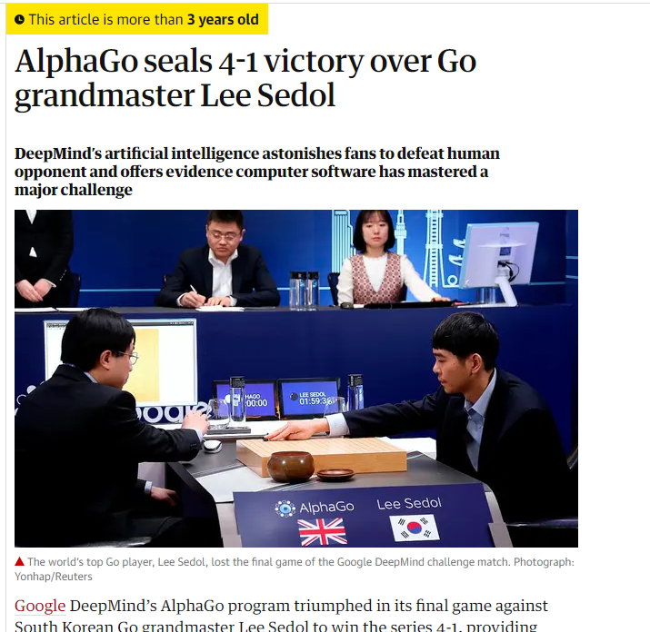

Slide 6
What is Artificial Intelligence?
Artificial Intelligence (AI) is concerned with making computers do things that otherwise require human intelligence.
Machine Learning.
Natural Language Processing.
Vision.
Speech and Voice.
Expert Systems and Knowledge Engineering (Representation, Inference).
Problem Solving (Search, Constraint Satisfaction).
Uncertainty Management (Fuzzy Logic, Probability).

Slide 7
Machine Learning
Machine learning is concerned with making computer learn without being explicitly programmed.
Machine learning is behind
Natural Language Processing/understanding.
Vision.
Speech and Voice.
Expert Systems and Knowledge Engineering (Representation, Inference).
Problem Solving (Search, Constraint Satisfaction).
Uncertainty Management (Fuzzy Logic, Probability).

Slide 8
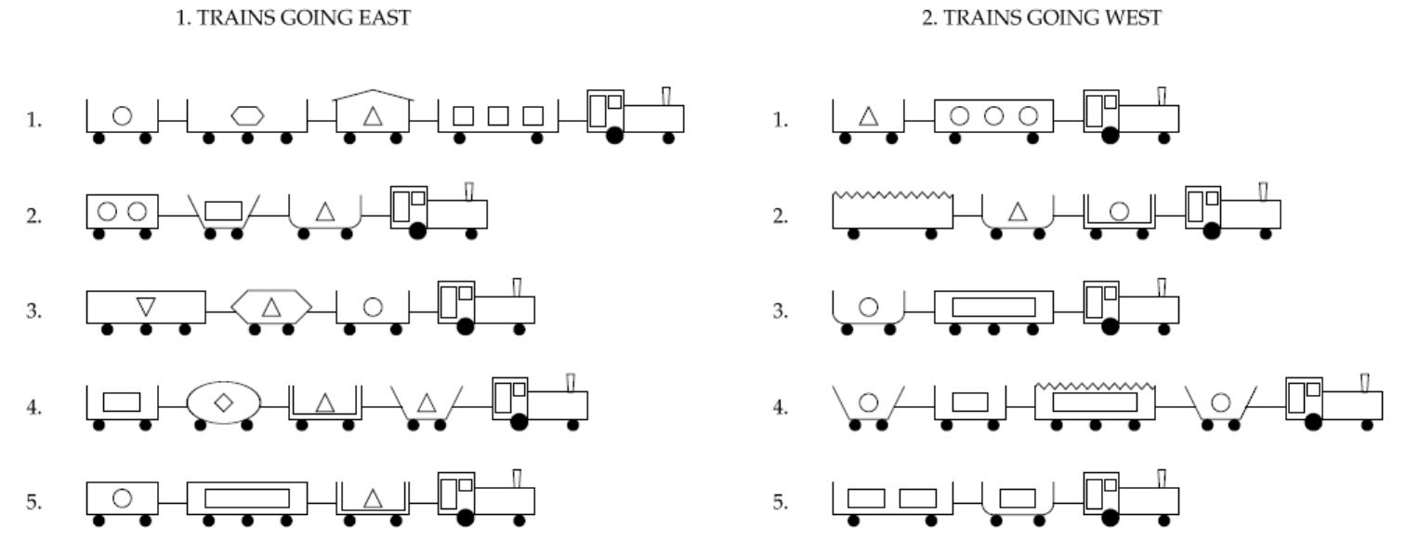


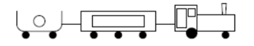
Supervised Machine Learning (Classification)

Slide 9
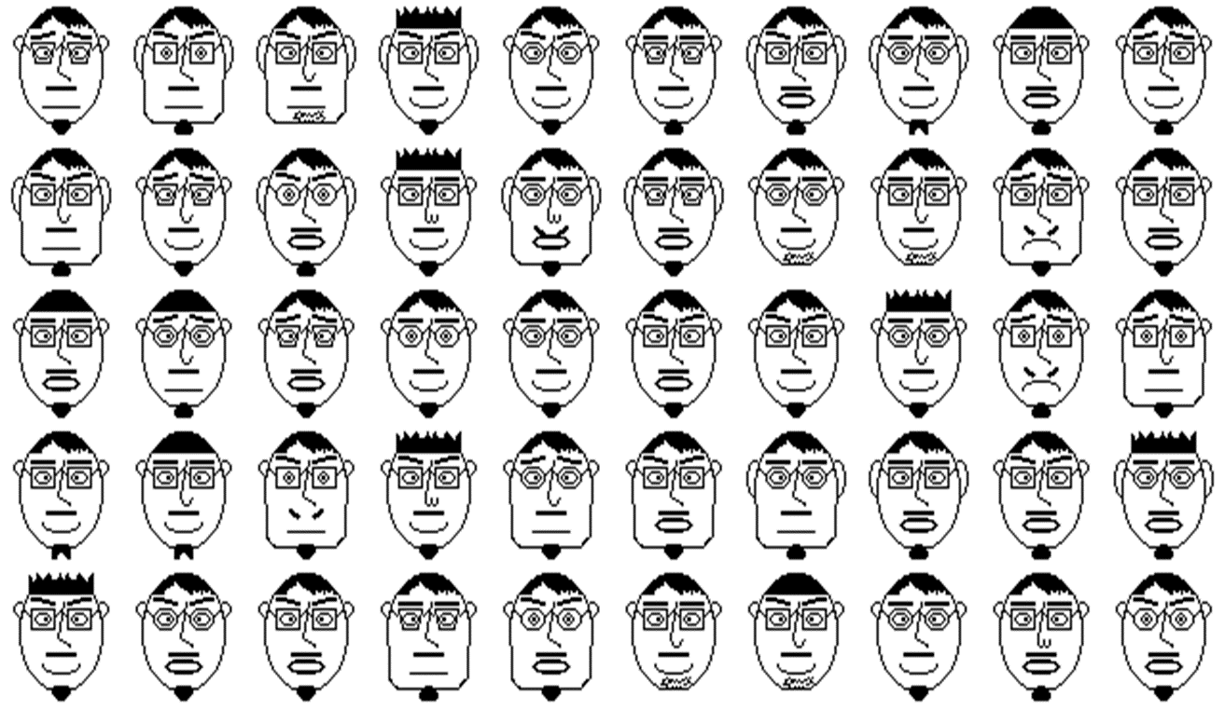
Unsupervised Machine Learning (Clustering)

Slide 10
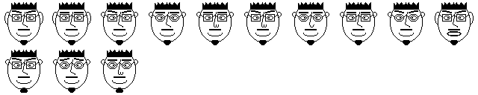
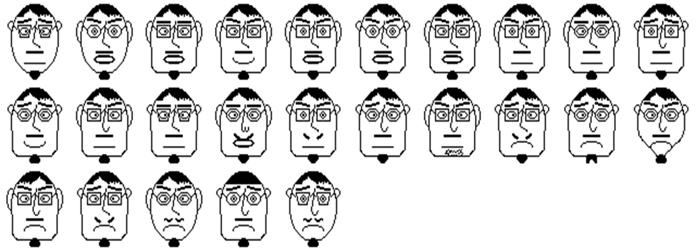
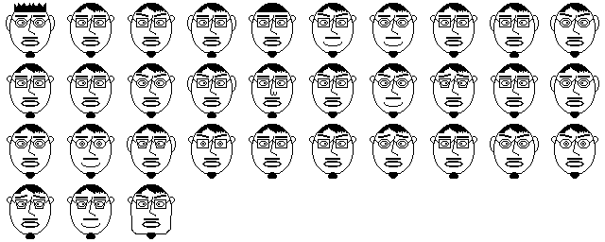
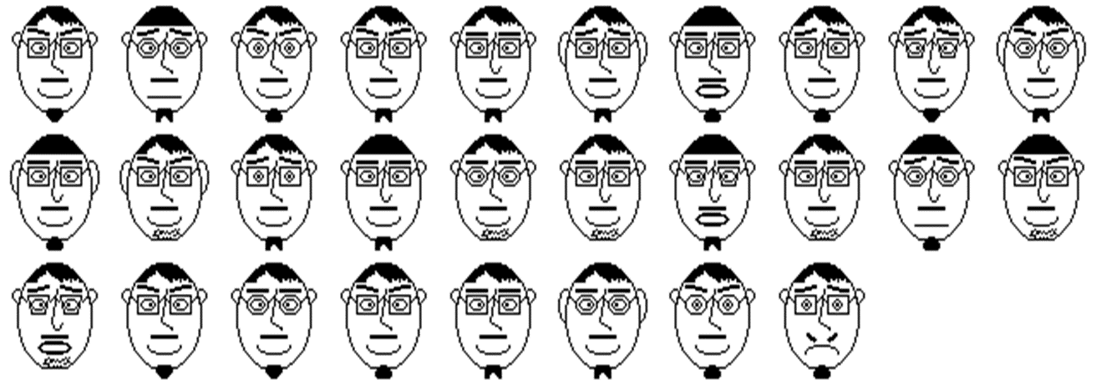

Slide 11
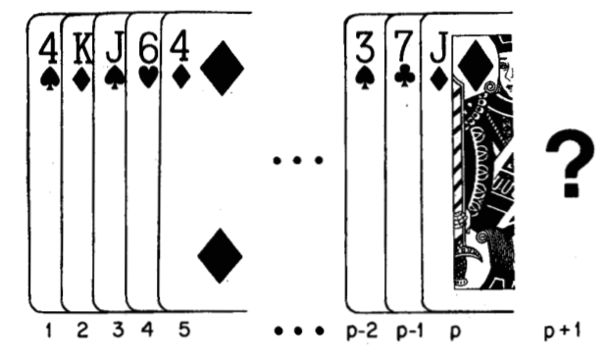
Sequential Pattern Discovery
Developing algorithms to allow computers to learn without being explicitly programmed.

Slide 12
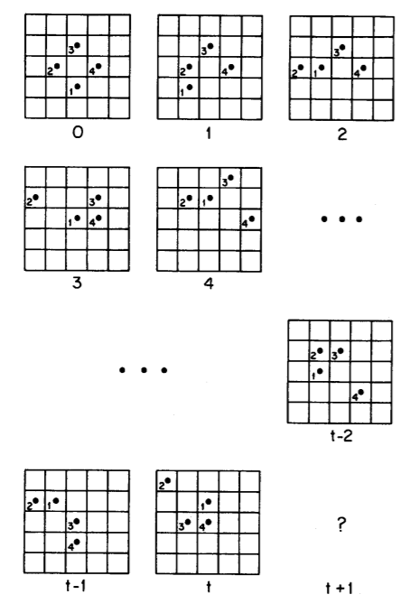

Slide 13
Machine Learning algorithms were used to discover hidden patterns

Slide 14
From Raw Data to Features
Features vector = (rank, suit, color, face cards, ace}
Developing algorithms to allow computers to learn without being explicitly programmed.
Position | rank | suit | color | Face cards | Ace
1 | 4 | Spade | Black | No | No
2 | K | Diamond | Red | Yes | No
3 | J | Spade | Black | Yes | No
4 | 6 | Heart | Red | No | No
… | … | … | … | … | …
P-1 | 7 | Club | Black | No | No
P | J | Diamond | Red | Yes | No
? | ? | ? | ? | ? | ?

Slide 15
From Raw Data to Features (Which features?)

Slide 16
From Raw Data to Features (Which Features?)

Slide 17

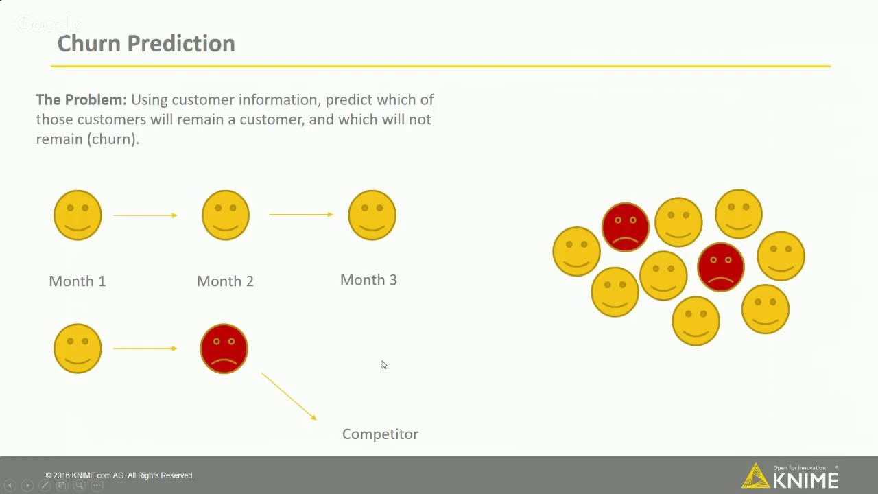
From Machine Learning to Data Mining
From
Supervised
Concept learning
To
Classification

Slide 18
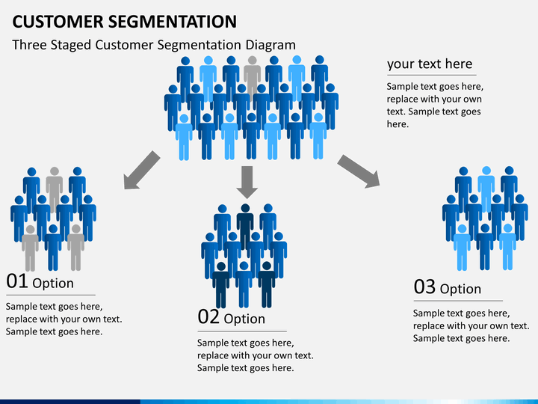
From Machine Learning to Data Mining
From
Unsupervised
To
Clustering

Slide 19

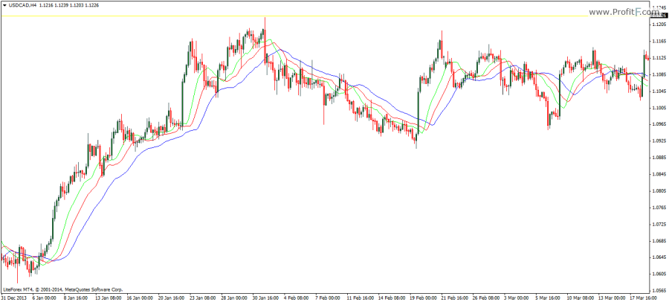
From Machine Learning to Data Mining
From
Sequential
Patterns
To
Sequential
Patterns

Slide 20
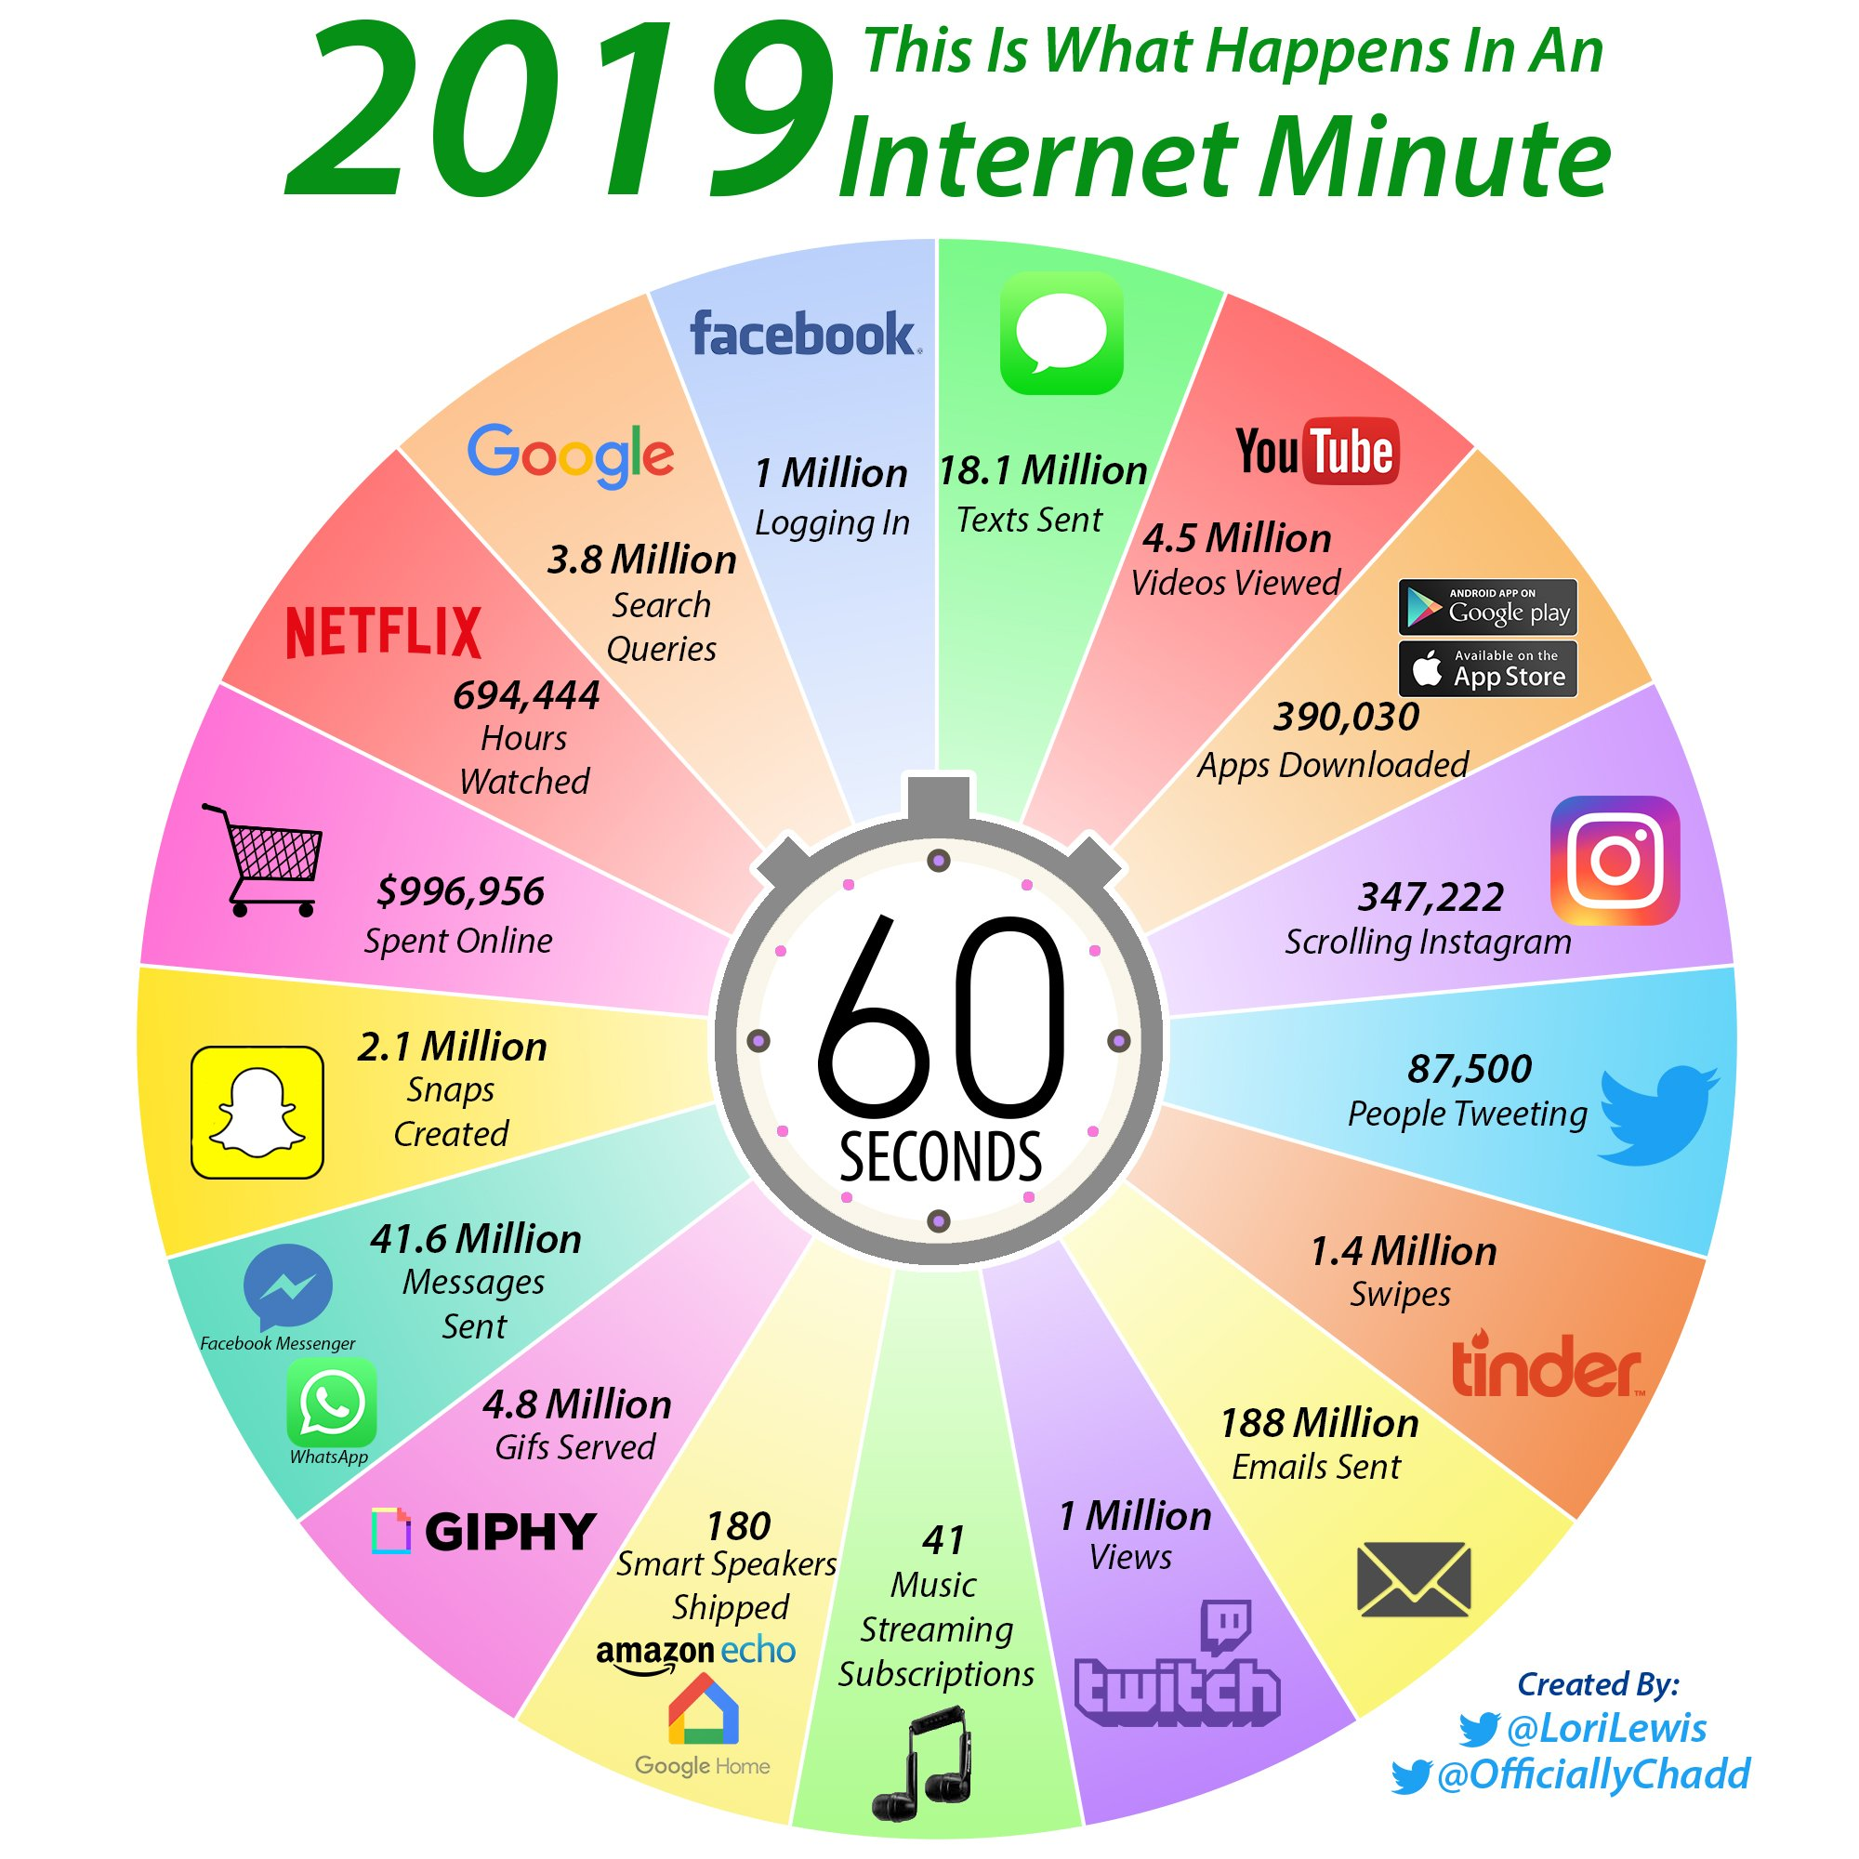

From Data Mining to Big Data Analytics

Slide 21
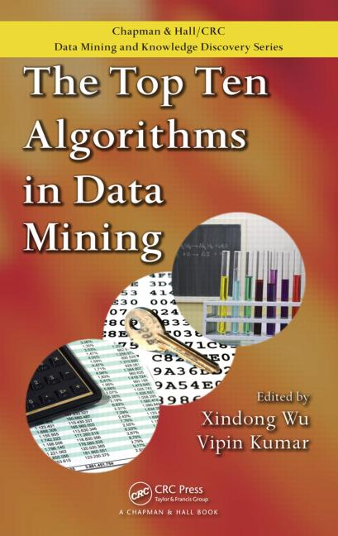
Top 10 Data Mining Algorithms
1. C4.5
2. k-means.
3. SVM.
4. Apriori.
5. EM.
6. PageRank.
7. AdaBoost.
8. kNN
9. Naïve Bayes.
10. CART.

Slide 22
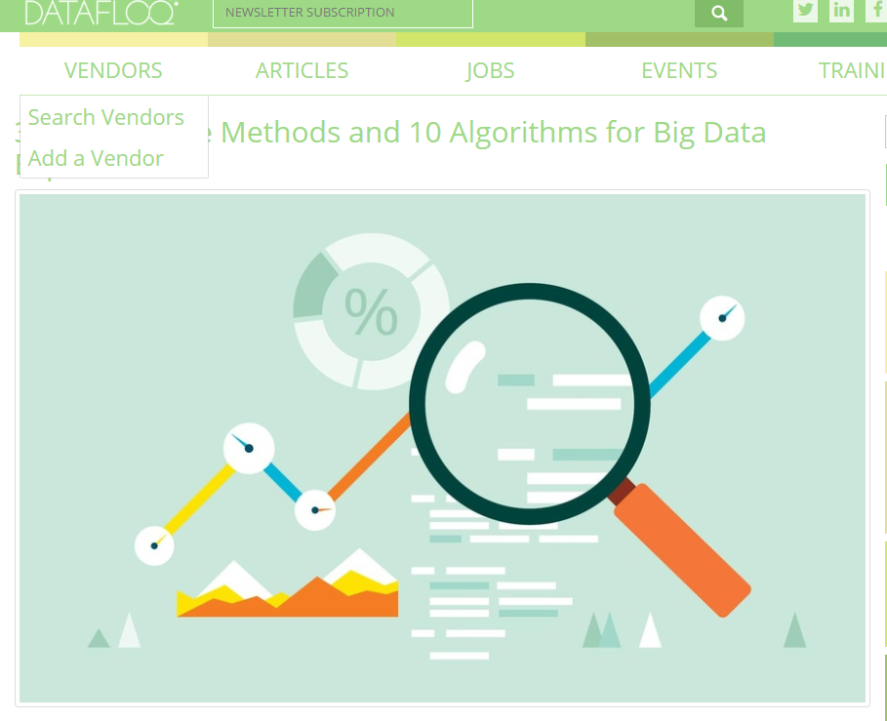
Top 10 Big Data Algorithms
1. k-means
2. Apriori
3. Linear Regression
4. Logistic Regression
5. C4.5
6. SVM
7. Association Rule Mining
8. EM
9. AdaBoost
10. Naïve Bayesian

Slide 23
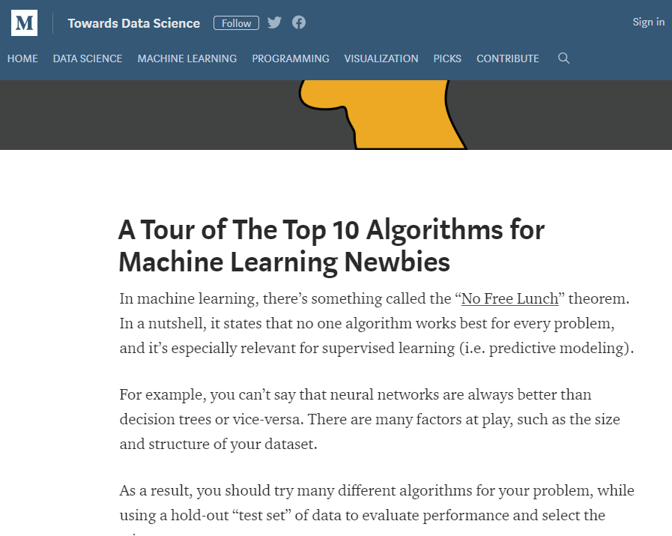
Top 10 Machine Learning Algorithms
1. Linear Regression
2. Logistic Regression
3. Linear Discriminant Analysis
4. CART
5. Naïve Bayes
6. kNN
7. Learning Vector Quantization.
8. SVM.
9. Bagging and Random Forest
10. Boosting and AdaBoost

Slide 24
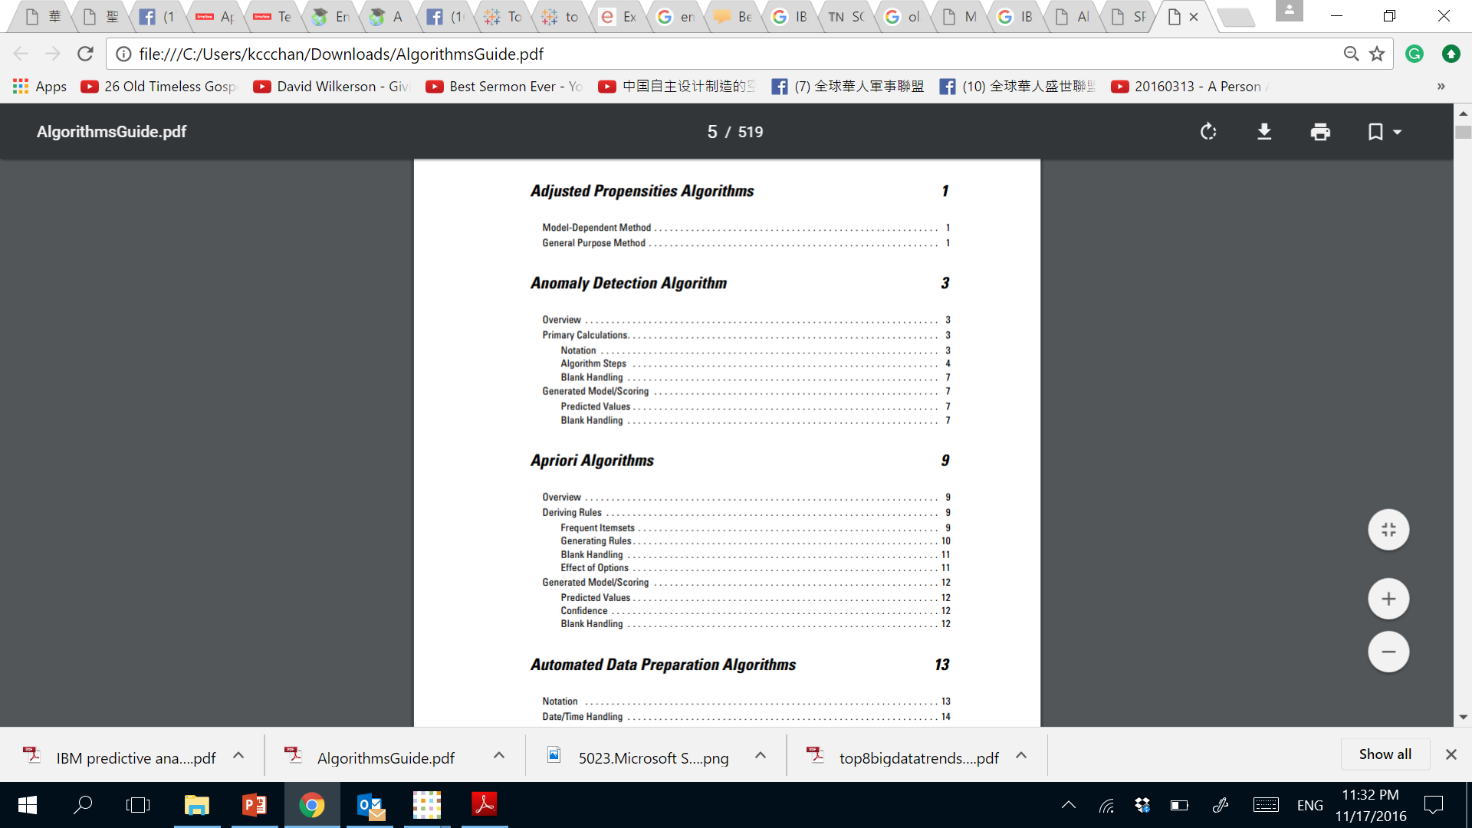
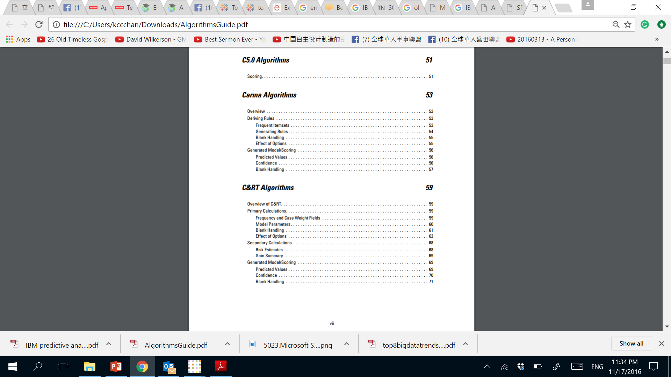
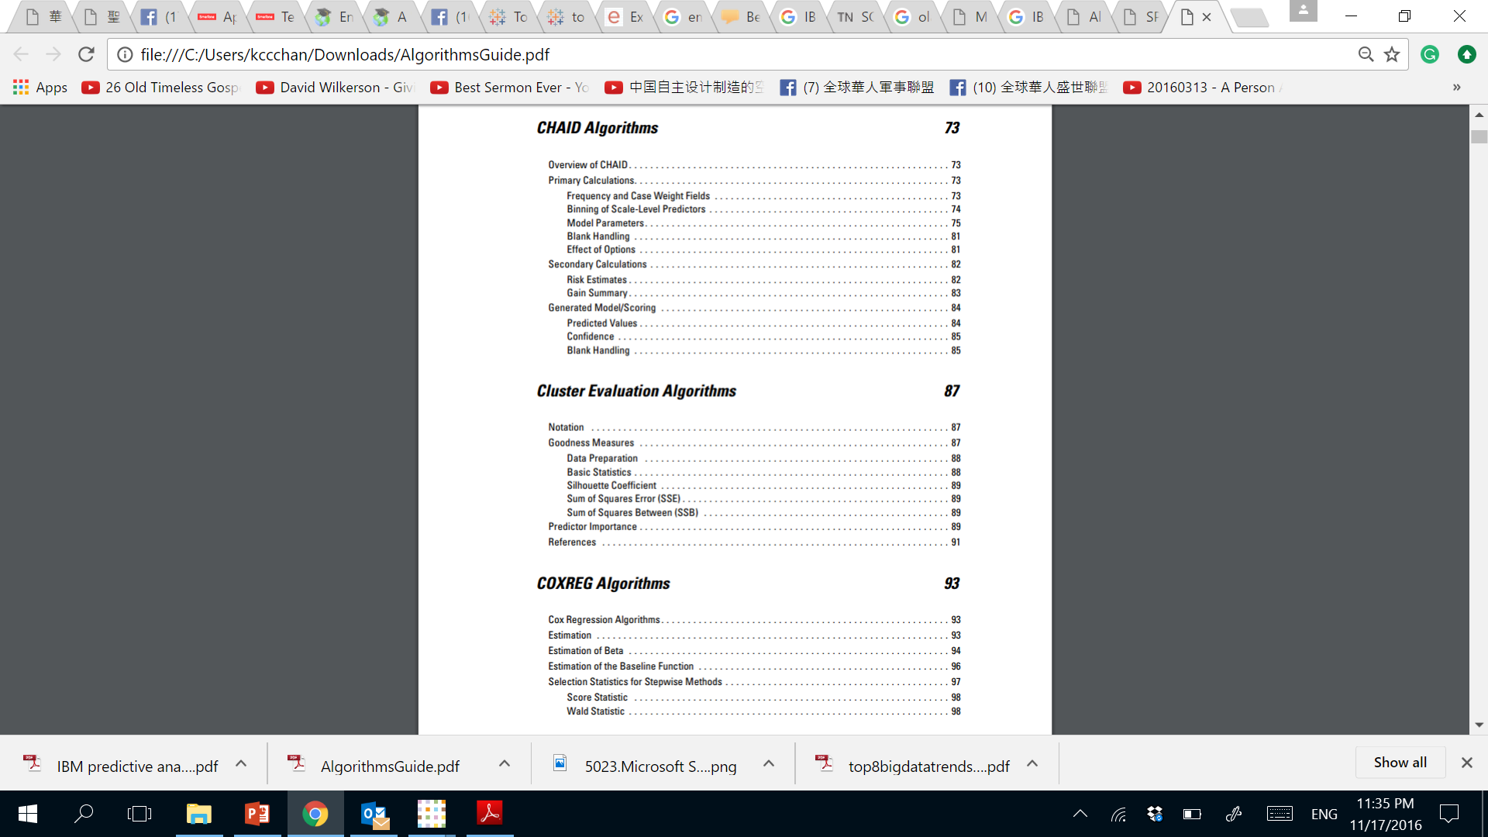
IBM Watson Changed from Data Mining to Machine Learning

Slide 25
Machine Learning is for Data Analytics Nowadays (≠Data Analysis)

Slide 26
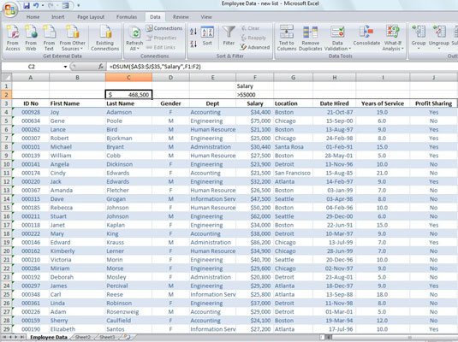
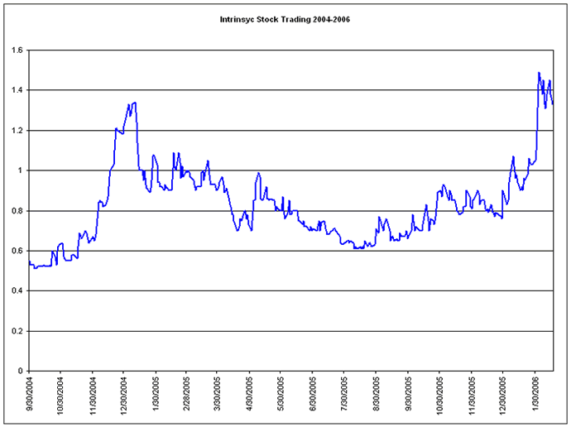
Data for Data Analysis is Traditional

Slide 27
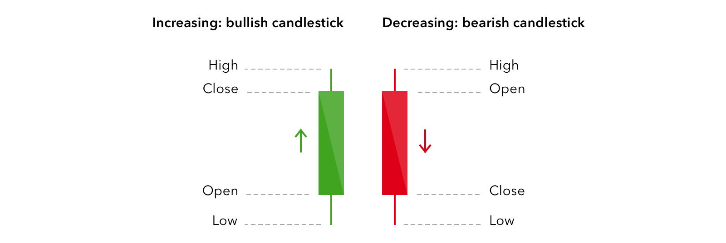
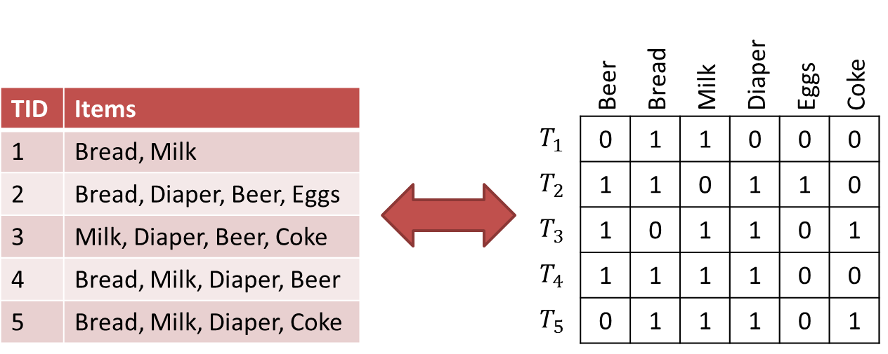
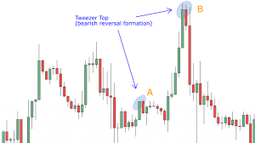
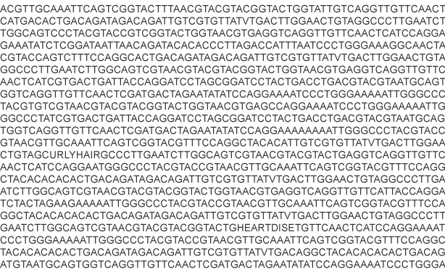
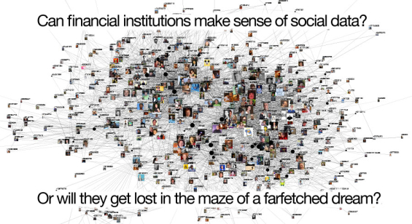
Data for Data Analytics
Transaction
Data
Multiple Time Series
Data
Graph/
Structural
Data
DNA
Sequential
Data

Slide 28
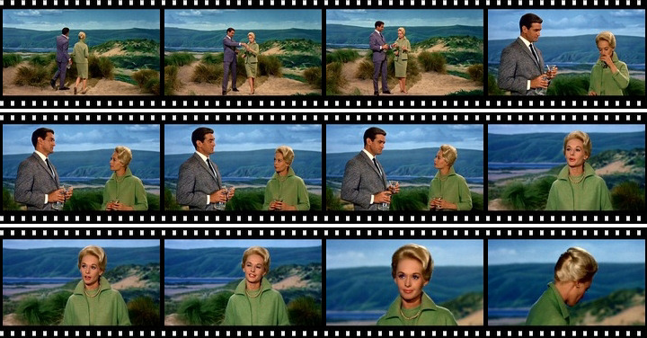
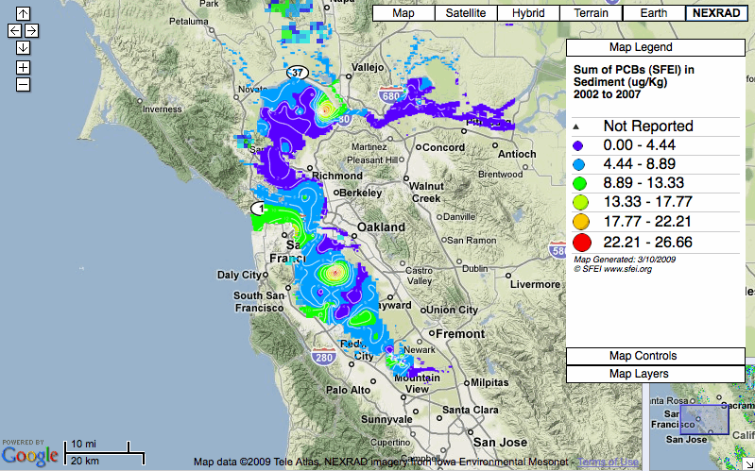
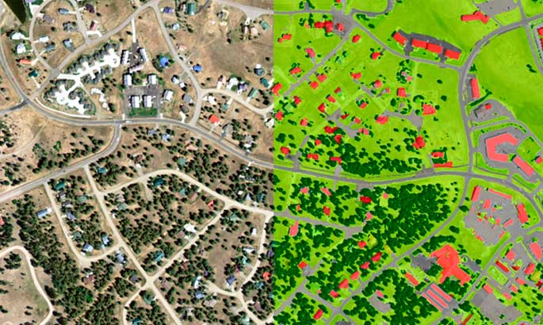

Data for Data Analytics
Video
Data
Spatial
Data
Temporal
Spatial
Data
Text
Data

Slide 29
Different Types of Data Require Different Machine Learning Methods

Slide 30
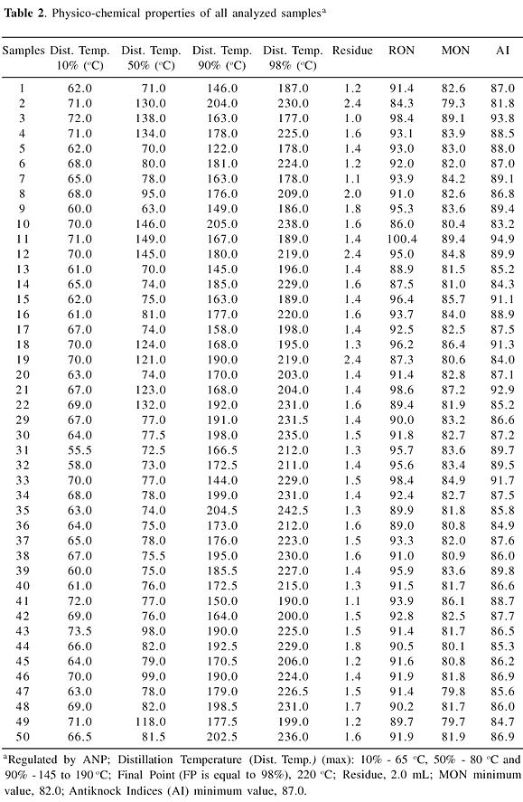
Data for Statistical Data Analysis

Slide 31
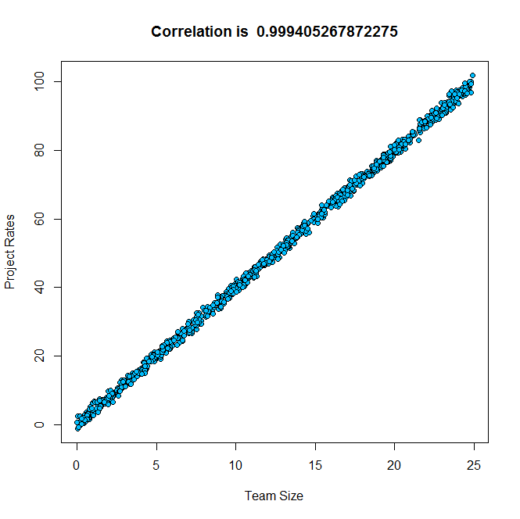
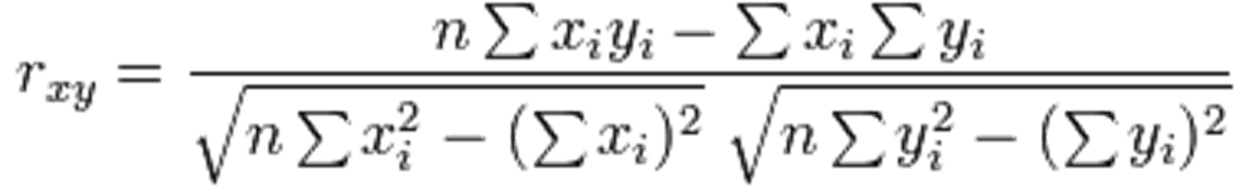
Finding Associations
Pearson Correlation Coefficient

Slide 32
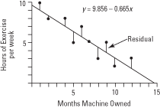
Linear Regression
Pizza Size
Corn Price

Slide 33
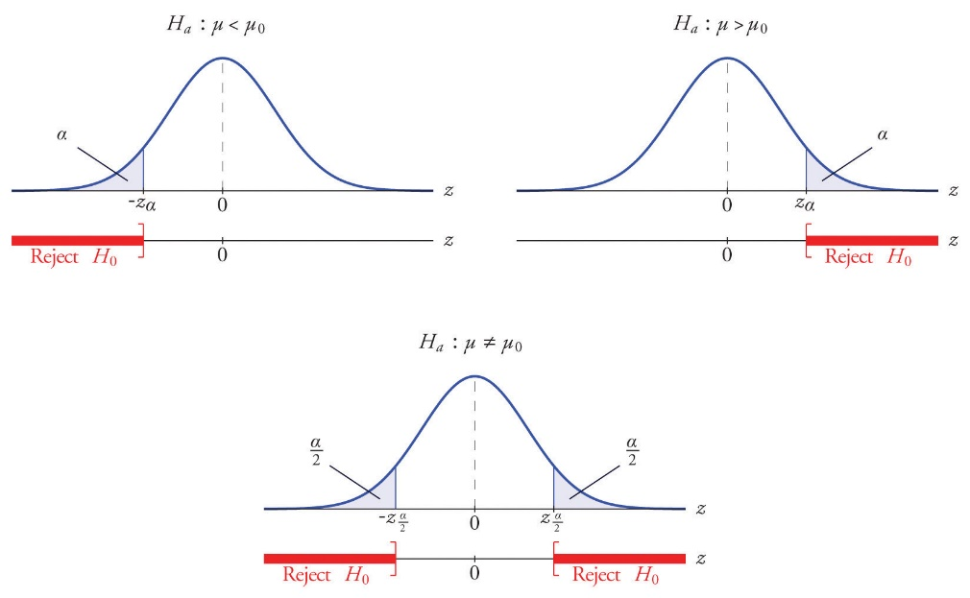
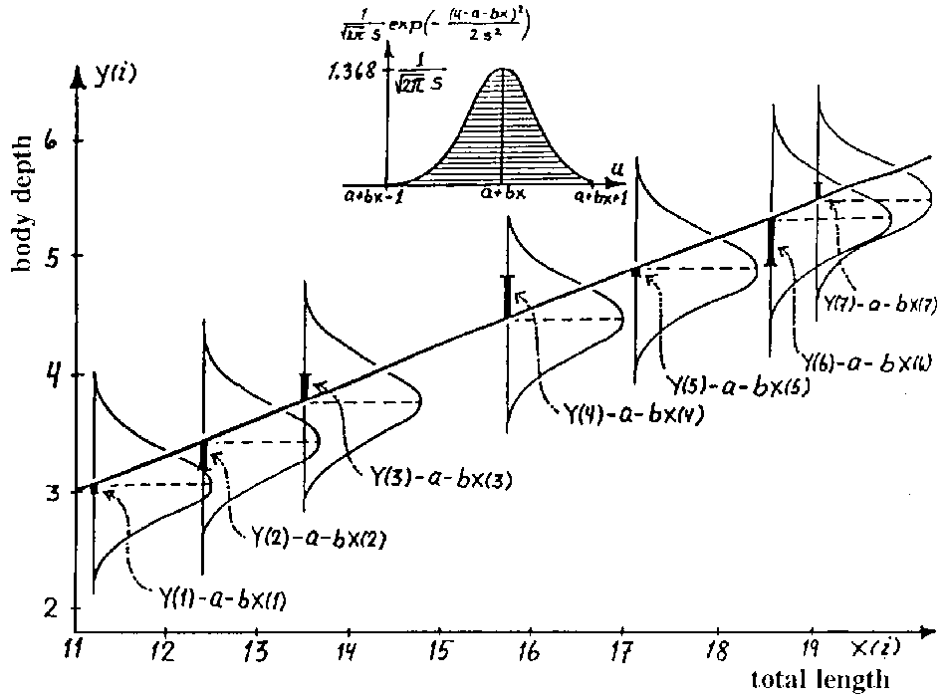
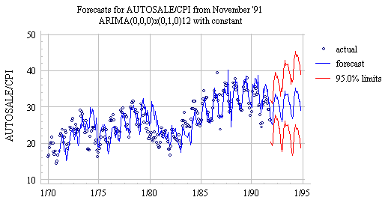
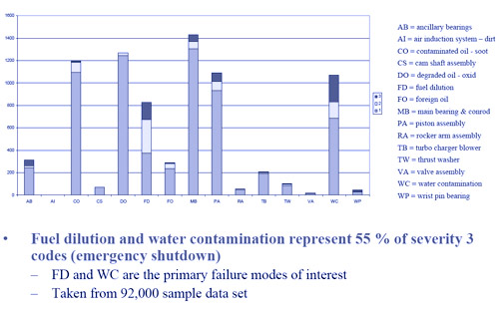


Slide 34
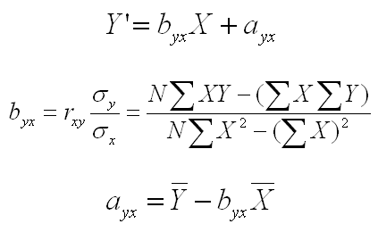
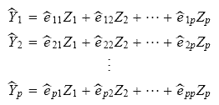
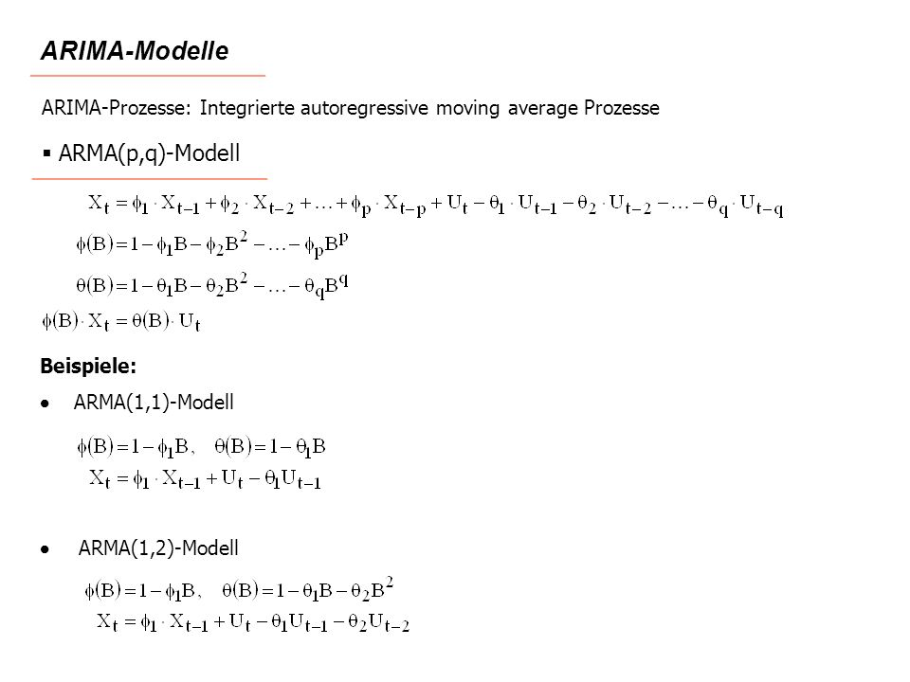
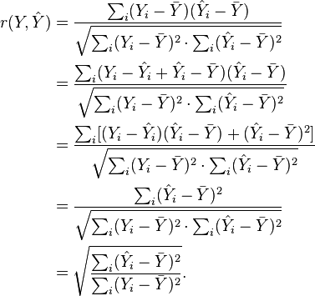
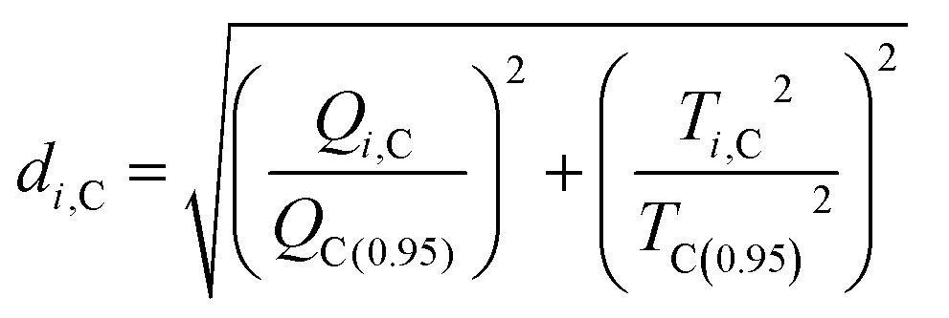
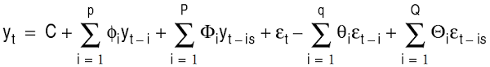

Slide 35
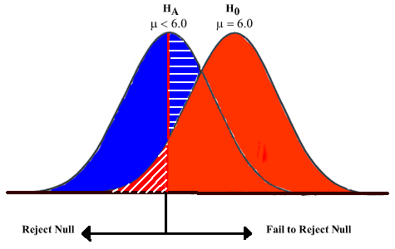
Hypothesis Testing

Slide 36
Statistical techniques
When should you use what?
t-test vs z-test vs. F-test
Chi-square test vs Shapiro-Wilk W-test.
Logistic regression, linear regression.
Principal Component and Factor Analysis.
ANOVA vs ARIMA.
Box-Jenkins vs. Holt-Winters.
Kendall tau vs Pearson’s

Slide 37
Data for Data Analytics and (State-of-Art Machine Learning)

Slide 38
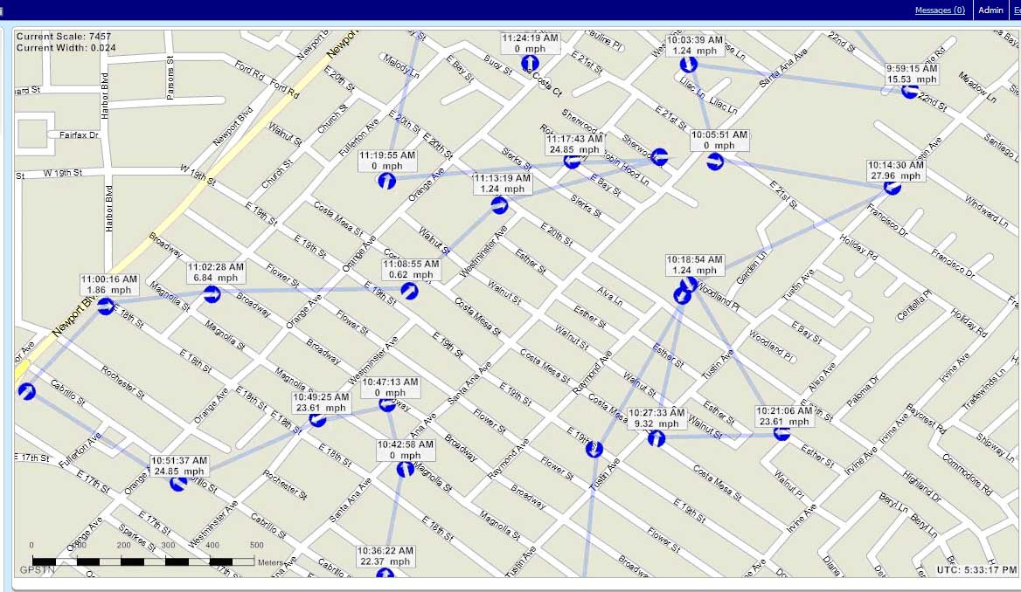
GPS Data for Data Analytics

Slide 39
GPS Data for Data Analytics
Driver ID, Time stamp, latitude, longitude, Driver Class
0001, 16/1/2016 13:15:34, 22.15.17, 114.10.23, Good
0001, 16/1/2016 13:15:58, 22.15.33, 114.10.72, Good
…
…
0317, 18/2/2016 09:02:13, 22.15.88, 114.10.12, Bad
0317, 18/2/2016 09:12:13, 22.15.13, 114.10.72, Bad
…
…

Slide 40
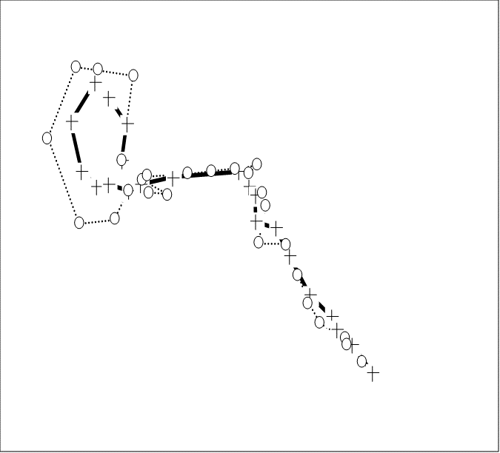
Radar Data for Data Analytics

Slide 41
Radar Data for Data Analytics
Target ID, Time stamp, latitude, longitude, Attitude
0001, 16/1/2016 13:15:34, 22.15.17, 114.10.23, 171.14
0001, 16/1/2016 13:15:58, 22.15.33, 114.10.72, 165.48
…
…
…
…
Where is the target in the next time instants?

Slide 42
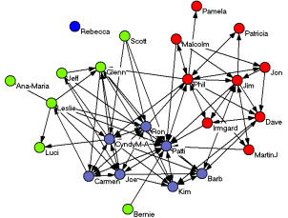
Social Network for Data Analytics

Slide 43
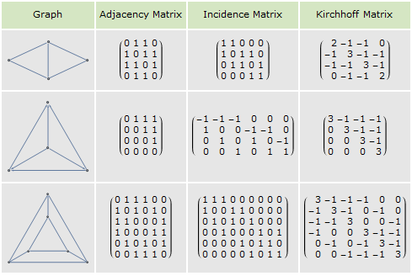
Social Network for Data Analytics

Slide 44
Machine Learning Algorithms
Ordinary Least Square Regression (OLSR).
Multivariate Adaptive Regression Splines (MARS).
Locally Estimated Scatterplot Smoothing (LOESS).
Linear Regression.
Logistic Regression.
Back Propagation Neural Network (BPNN).
Apriori algorithm.
k-means, k-mode, k-medians, k-medoids.
k-nearest Neighbor (k-NN).
Self-Organizing Map (SOM).
Learning vector Quantization (LVQ).
Locally weighted learning (LWL).
Ridge Regression
Least Absolute Shrinkage and Selection Operator (LASSO).
Elastic Net.
Least Angle Regression (LARS).
Classification and Regression Tree (CART).
ID3.
C4.5 and C5.0
Chi-Squared Automatic Interaction Detection (CHAID).
Decision Stump.
M5.
Conditional Decision Trees.
Naïve Bayes.
Gaussian Naïve Bayes.
Multinomial Naïve Bayes.
Averaged One-Dependence Estimators (AODE).
Bayesian Belief Network (BBN).
Bayesian Network (BN).
Expectation Maximization (EM).

Slide 45
What Problems Do These Machine Learning Algorithms Solve?
Hierarchical Clustering.
Eclat algorithm.
Perceptron
Hopfield Network.
Radial Basis Function Network (RBFN).
Deep learning
Deep Boltzmann machine (DBM).
Deep belief networks (DBN).
Convolutional neural network (CNN).
Stacked Auto-Encoders.
Principal Component Analysis (PCA).
Principal Component Regression (PCR).
43. Partial Least Squares Regression (PLSR)
44. Sammon Mapping
45. Multidimensional Scaling (MDS)
Projection Pursuit
Linear Discriminant Analysis (LDA)
Mixture Discriminant Analysis (MDA)
Quadratic Discriminant Analysis (QDA)
Flexible Discriminant Analysis (FDA)
Boosting
Bootstrapped Aggregation (Bagging)
AdaBoost
Stacked Generalization (blending)
Gradient Boosting Machines (GBM)
Gradient Boosted Regression Trees (GBRT)
Random Forest

Slide 46
Multiple Time Series Data

Slide 47
Graph Analytics for Discovering of Patterns in Networked Data
Data Analytics is concerned with the uncovering of hidden patterns from large data sets using machine learning methods.
Graph Analytics is an area in data analytics
When data involved are graph/networked data.
The data are structural and the hidden patterns are structural patterns.
Related to graph mining and also structural pattern recognition.
But large data set size.

Slide 48
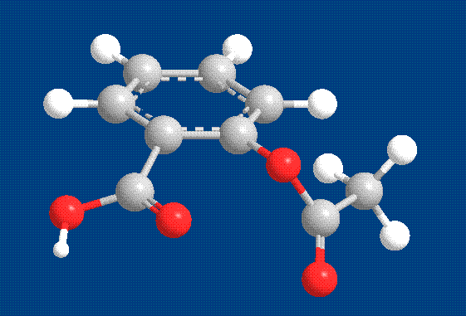



Graph Data are Networks Represented as Graphs
Large Dataset Size
from H. Jeong et al Nature 411, 41 (2001)
Aspirin
Yeast protein interaction network
Facebook
Co-author network

Slide 49


How many graphs? One or Many Graphs

Slide 50



What Types of Graphs
Directed vs. undirected.
Labeled vs. unlabeled (edges & vertices).
Weighted and unweighted.

Slide 51
The Graph Analytics Problems
Multiple Labeled graphs.
Frequent subgraphs.
Single Unlabeled graphs.
Graph clustering.

Slide 52

Graph Mining of Multiple Labeled Graphs
Discovering frequent patterns (subgraphs) in multiple labeled graphs
Apriori-based algorithm, FSG.
Pattern-growth based algorithm, gSPAN.

Slide 53
The FSG Algorithm
frequent
1-subgraphs
frequent
2-subgraphs
3-candidates
frequent
3-subgraphs
4-candidates
. . .
. . .
frequent
4-subgraphs
Notes:
In this page, a simple scenario of FSG algorithm is shown:
All the frequent 1-sub-graphs and 2-sub-graphs are identified in the set of graph transactions.
Based on the frequent sub-graphs identified in the first step. A set of candidates of 3-sub-graphs are generated. For example, the leftmost 3-sub-graph is generated by joining the second 1-subgraph and first 2-subgraph. The third 3-candidate can be generated by joining 1st 1-sub-graph and 1st 2-subgraph, etc.
All the 3-candidates will be check whether or not they satisfy the MinSup and those sub-graphs whose frequency is lower than MinSup are excluded from the candidate set. As a result, the set of 3-subgraphs are made up of the left 3-candidates.

Slide 54
An Example
GRAPH DATASET
(T1)
(T2)
(T3)
FREQUENT PATTERNS
(MIN SUPPORT IS 2)
(1)
(2)

Slide 55

Graph Analytics – Graph Clustering of Unlabeled Graphs
Discovering Graph clusters in a large graph
Cohesive sub-groups or communities.
Identify conceptually interesting patterns.

Slide 56

Defining Clusters in Graphs
Discover Local definitions: focus on the subgraph only
Clique: Vertices are all adjacent to each other
Strict definition, NP-complete problem
n-clique, n-clan, n-club, k-plex
k-core: Maximal subgraph that each vertex is adjacent to at least k other vertices in the subgraph
LS-set (strong cluster): $k_{v}^{int}>k_{v}^{ext}, ∀v∈C$ (sub-graph)
$k_{v}^{int}, k_{v}^{ext}$: Internal and external degrees of $v∈C$
Weak cluster: $k_{int}^{C}>k_{ext}^{C}$
$k_{int}^{C}, k_{ext}^{C}$: Internal and external degrees of $C$
Fitness measure: Intra-cluster density, cut size, …

Slide 57

Markov Graph Clustering (MCL)
A heuristic algorithm based on random walk
Find densely connected regions in the graph as clusters
Based on the assumption that the probability that randomly walking from a node to another connected node in the same cluster is higher than that of nodes in another, as the edges in the same cluster are denser
The clustering procedure satisfies the properties of “Markov Chains”
Ref: http://micans.org/mcl

Slide 58
Topology Is Not Enough (Sometimes)
Graphs arising from physical domains have a strong geometric nature.
This geometry must be taken into account by the graph mining algorithms.
Geometric graphs.
Vertices have physical 2D and 3D coordinates associated with them.

Slide 59

Attributed Graphs
Effective representation of interrelations
Vertices – Data samples
Edges – Sample-sample relationship
Features – Characteristics other than topology
Vertex with content features-Attributed Graph (AG)
G = (V, E, Λ)
Vertex set V= {v_{i} | 1 ≤ i ≤ n_{V}}
Edge set E = {e_{ij} | 1 ≤ i, j ≤ n_{V}, i ≠ j}
n_{V} -by-n_{V} adjacency matrix
Attribute set Λ = {att_{i} | 1 ≤ i ≤ n_{Λ}}
Graph clusters are formed by individuals that interact or are more similar with each other than those outside the group.
education;school;id;anonymized feature# 1040 | education;school;id;anonymized feature 1040
education;school;id;anonymized feature 52 | education;school;id;anonymized feature 52
location;id;anonymized feature 128 | education;school;id;anonymized feature 52
Small attributed graph extracted from facebook.com

Slide 60
Real-world graphs
Real relational data modeled as graphs
Vertices-data entities
Webpages
social network users
Authors
proteins
Edges-interrelationship between data entities
Friendship
Citation
co-authorship
Interaction
Attributes-characterize data entities
User profiles
Article keywords
Research domains
Protein sequence fingerprints.

Slide 61


Why Attributed Graphs?
AGs are more descriptive
Topology
Node descriptions
Heterogeneous information considered in analysis.
Latent topological structure
Latent contextual descriptions
More informative meaningful results.
Meaningful attributes included
Communities in social graphs with/without contextual contents (Attributes)

Slide 62



Slide 63
Densely connected subgraphs may not be protein complexes
Complex #550.2.63
P06787
P22517
Complex #550.2.66
P53066
P23287
P25296
Q04439
P14747
P36006
P32486
P27466
P32341
Notes:
Discovered by MCL from krogan data set (#45)

Slide 64

Filter interactions with |γ_{ij}| < 1.96
Notes:
The magnitude of γ_{ij} is calculated for each interaction and they are indicated using different line styles as shown in Fig. 2. The solid line refers to |γ_{ij}| ≥1.96, and the dotted line refers to |γ_{ij}| <1.96. If the value of |γ_{ij}| ≥1.96, we can conclude that the protein functions performed between the vertices v_{i} and v_{j} are significantly interdependent. Otherwise, they are not. The interactions,e_{P43535 Q02260}, e_{P36048 P32639}, and e_{Q00362 Q04377}, that have low γ_{ij} value in the sub-network, will be filtered and the remaining graph is shown in Fig. 2(b).

Slide 65
Pruning of Edges
Test Statistics (TS)
obs(e_{ij}) = Total number of edges in G that connects vertices that perform the functions of f_{i} and f_{j} respectively.
exp(e_{ij}) = (Total number of edges in G that connects vertices that perform the function f_{i}) × (Total number of edges in G that connects vertices that perform the function f_{j}) / (Total number of edges in G)
TS = γ (obs(e_{ij}) - exp(e_{ij})) where
Notes:
The magnitude of TS reflects significance of functional interaction.
TS approximates N(0.1).
If |TS| ≥1.96, interaction between f_{i} and f_{j} is significant at confidence level of 95%.
This interaction relationship and the proteins that perform the functions f_{i} and f_{j} are likely part of a protein complex

Slide 66


Identify Seed Vertex
Each protein considered in turn as seed vertex.
A maximum significant score obtained for the seed vertex.
Proteins that interact with the seed with a significant score that is higher than a threshold will be included.
local-TS(v_{i}) = b_{i} × µ
where µ = Set by users; take positive value less than one

Slide 67
References
Hu, L., Chan, K.C.C. Yuan, X., and Xiong, S., “A Variational Bayesian Framework for Cluster Analysis in A Complex Network,” IEEE Transactions on Knowledge and Data Engineering. (To Appear).
Lam, W.W.M., and Chan, K.C.C., "Discovering Functional Interdependency Relationship in PPI Networks for Protein Complex Identification," IEEE Transactions on Biomedical Engineering. Vol. 59, No. 4, April, 2012, pp.899-908.

Slide 68
Computational Intelligence and Graph Analytics
Computational Intelligence (CI)
Fuzzy logic
Neural Networks
Evolutionary computation
What offer to graph analytics
New analytical paradigms- Fuzzy learning, deep learning
Effective optimization techniques- Evolutionary global optimization

Slide 69


Slide 70
References
L. Hu, and K.C.C. Chan, “Fuzzy clustering in a complex network based on content relevance and link structures,” IEEE Transactions on Fuzzy Systems, vol. 24, no. 2, pp. 456-470, 2015.
T. He, and K.C.C. Chan, “Discovering fuzzy structural patterns for graph analytics,” IEEE Transactions on Fuzzy Systems, vol. 26, no. 5, pp. 2785-2796, 2018.

Slide 71

From Significant Statistical association to fuzzy Association for Graph Clustering
Why fuzzy clustering in graphs
Multiple cluster membership can be automatically learned
Overlapping clusters allow to be discovered
Efficient clustering framework

Slide 72

Fuzzy graph clustering
Identify clusters from graph topology and node attributes
Node-cluster membership concerns heterogeneous information
Overlapping clusters allowed

Slide 73



Node association w.r.t. attributes
Information theoretic based method
M (graph topology) and A (node association) for fuzzy graph clustering
$$φ_{ij}=\frac{r(v_{i},v_{j})}{H(v_{i},v_{j})}$$
$$H(v_{i},v_{j})=−\sum_{k}{\sum_{m}{\operatorname{Pr}{(}att_{ik},att_{jm})⋅\operatorname{logPr}{(}att_{ik},att_{jm})}}$$
$$r(v_{i},v_{j})=\sum_{k}{\sum_{m}{\operatorname{Pr}{(}att_{ik},att_{jm})⋅\log{\frac{\operatorname{Pr}{(}att_{ik},att_{jm})}{\operatorname{Pr}{(}att_{ik})⋅\operatorname{Pr}{(}att_{jm})}}}}$$

Slide 74
Two clustering strategies
Fuzzy co-clustering
Simultaneously learning fuzzy membership from graph topology and node association
Fuzzy clustering in addictive graph
Learning fuzzy membership from a weighted graph constructed based on graph topology and node association

Slide 75


Fuzzy co-clustering
Graph Data matrix
Objective function based fuzzy clustering
$$Y=\left[\begin{aligned}αM 0 \\ 0 (1−α)A\end{aligned}\right]$$
$$\text{maximize} \\ O=tr(S^{T}YX)−\frac{1}{2}\left[{\left|C\right|}_{F}^{2}+{\left|X\right|}_{F}^{2}+{\left|XC^{T}\right|}_{F}^{2}\right] \\ S^{T}=\left[C^{T},C^{T}\right] \\ subject to X≥0, C≥0,Ce_{1}=e_{2}$$

Slide 76


Clustering in addictive graph
Graph Data Matrix
Objective function
Both two models can be optimized by standard constrained optimization techniques
$$Y=αM+βA$$
$$\text{maximize} \\ O=tr\left(U^{T}YU\right)−δtr\left(U^{T}M\left(Ue_{1}e_{2}^{T}−U\right)\right)−\frac{θ}{2}{\left|U\right|}_{F}^{2} \\ subject to U≥0, Ue_{1}=e_{2}$$

Slide 77
References
T. He, and K.C.C. Chan, “Evolutionary graph clustering for protein complex identification,” IEEE/ACM Transactions on Computational Biology and Bioinformatics, vol. 15, no. 3, pp. 892-904, 2018.

Slide 78

Evolutionary clustering in AG
Evolutionary computation
Effective optimization technique
Evolutionary AG clustering
Not fully explored
Most previous evo-methods concern graph topology

Slide 79

Evolutionary clustering in AG
Attribute-relevance preserving weighted graph
Identifying significant attribute pairs
Edges reweighted according to any effective similarity measure
Only relevant attributes considered
Reduce noise from irrelevant attributes
$$diff(att_{i},att_{j})=\frac{o(att_{i},att_{j})−e(att_{i},att_{j})}{\sqrt{e(att_{i},att_{j})(1−\frac{o(att_{i}+)}{n_{E}})((1−\frac{o(att_{j}+)}{n_{E}}))}}$$

Slide 80

Evolutionary strategy for graph cluster analysis
Evolutionary Graph Clustering
Input: Attributed Graph Output: A set of clusters C={c_{i}, 1≤i≤n_{C}} Construct weighted Attributed Graph; population initialization; done = false; while (done == false) { for (i = 0; i < maxdescendant; i ++) { crossover; Self-Variation; insertion of individual; elimination; } if(terminal-condition) { done = true; } else { if(re-initialization) { population initialization } } } return C;
Evaluation function:
$IoC_{wG}=\sum_{i=1}^{S}{\frac{n_{V_{i}}}{n_{V}}IC_{C_{i}},}IoC_{C_{i}}=\frac{\sum_{v_{j},v_{k}∈C_{i}}{w_{jk}}}{\sum_{v_{j}∈C_{i}}{w_{jk}}}$
Local search for population improvement
${diff}_{max}=\max_{k}\left[vc_{ik}−E\left(d_{v_{i}c}\right)\right]$
$E\left(d_{v_{i}c}\right)=\sum_{1}^{S}{\frac{vc_{ij}×vc_{ij}}{w_{v_{i}}}}$
Relocate a vertex to cluster diff_{max} if necessary
Cluster affiliation uncovered when EC converges

Slide 81
References
Huang, Y.A., Hu, P., Chan, K.C.C., and You, Z.H., "Graph Convolution for Predicting Associations between miRNA and Drug Resistance from Raw Data," Bioinformatics. (Accepted).
Hu, P., Huang, Y.A, Chan, K.C.C. and You, Z.H., "Learning Multimodal Networks from Heterogeneous Data for Prediction of lncRNA-miRNA Interactions". ACM/IEEE Transactions on Computational Biology and Bioinformatics. (Accepted).

Slide 82
Multimodality – multiple networks
Remote sensing with multi-spectral and panchromatic images.
Target tracking with sensors data.
Omics data.
Heterogeneous social network data.
Temporal-spatial data.

Slide 83
Learning in graphs via neural networks
Learning based on neural networks
One of the dominant paradigms for machine learning and data mining
Low dimensional representations (embeddings) for vertices
Compactly representing vertices in graph
Effective in various analytical tasks
Node Clustering
Node Classification
Link Prediction
Recommendations

Slide 84

Representation Learning via Deep Graph Fusion
Data for either node attributes or adjacency are sparse
Deterring one from learning meaningful representations from graphs
An effective framework for fusing multiple graphs is proposed
Node embeddings can be learned from fused network via deep learning frameworks

Slide 85

A Framework for Deep graph fusion
Similarity Networks
Initial Fusion
Optimized Fusion
Deep representation Learning
Node embeddings
Similarity networks can be constructed by any effective similarity measure

Slide 86

Learning optimized network fusion and Node embeddings
Iterative method for learning optimal fused network
Graph Kernel $K\left(i,j\right)=\frac{L\left(i, j\right)}{2\sum_{k≠i}{L\left(i, k\right)}}$
K affinity neighbor graph $Q\left(i,j\right)=\frac{L\left(i, j\right)}{\sum_{k∈N_{i}}{L\left(i, k\right)}}$
Then $K^{(opt)}=\frac{\sum_{v=1}^{m}{K^{v}}}{m}$, where $K^{(v)}=Q^{(v)}×\left(\frac{\sum_{k≠v}{K^{(k)}}}{m−1}\right)×{(Q^{(v)})}^{T}, v=1,2,3,…, m$
Node embeddings can be learned from K^{(opt)} via deep auto-encoder
Comparisons between non-fused network and fused network

Slide 87
Results obtained by the proposed approaches
Mentioned methods have been used in various AG data to perform different learning tasks
Social community detection
Document classification
Protein complex identification
Precise medication
Effective in different learning tasks in graph structured data

Slide 88
Performance comparison in social graphs
 | Twitter |  |  | Ego-facebook |  |  | Googleplus
Approach | NMI | Acc | FARI | NMI | Acc | FARI | NMI | Acc | FARI
AP | 0.598^{2nd} | 0.479^{3rd} | 0.123 | 0.528^{2nd} | 0.416 | 0.194^{1st} | 0.355 | 0.273 | 0.095
CoDa | 0.584^{3rd} | 0.471 | 0.182^{3rd} | 0.524^{3rd} | 0.502^{3rd} | 0.13^{3rd} | 0.373 | 0.375^{3rd} | 0.079
SC | 0.493 | 0.305 | 0.094 | 0.52 | 0.447 | 0.126 | 0.33 | 0.296 | 0.081
FCM | 0.08 | 0.09 | 0.016 | 0.28 | 0.208 | 0.056 | 0.128 | 0.181 | 0.031
iRFCM | 0.535 | 0.37 | 0.172 | 0.315 | 0.282 | 0.074 | 0.266 | 0.318 | 0.054
CESNA | 0.572 | 0.528^{1st} | 0.169 | 0.483 | 0.623^{1st} | 0.118 | 0.42^{2nd} | 0.47^{2nd} | 0.105^{3rd}
RTM | 0.028 | 0.099 | 0.014 | 0.227 | 0.167 | 0.061 | 0.023 | 0.151 | 0.019
ECDA | 0.529 | 0.385 | 0.184^{2nd} | 0.322 | 0.234 | 0.099 | 0.395^{3rd} | 0.341 | 0.122^{2nd}
FSPGA | 0.641^{1st} | 0.513^{2nd} | 0.241^{1st} | 0.579^{1st} | 0.588^{2nd} | 0.17^{2nd} | 0.489^{1st} | 0.519^{1st} | 0.149^{1st}
FSPGA: The proposed fuzzy co-learning method
Twitter, Ego-facebook, and Googleplus are three widely-used social graph datasets

Slide 89
Clustering performance in biological graphs
 | Krogan |  |  | DIP |  |  | BioGrid
Approach | NMI | Acc | FARI | NMI | Acc | FARI | NMI | Acc | FARI
AP | 0.692^{1st} | 0.187^{3rd} | 0.11 | 0.688^{2nd} | 0.117^{2nd} | 0.098 | 0.109 | 0.016 | 0.003
CoDa | 0.688^{2nd} | 0.199^{2nd} | 0.298^{1st} | 0.463 | 0.068^{3rd} | 0.045 | 0.299 | 0.035 | 0.017
SC | 0.609 | 0.079 | 0.026 | 0.588 | 0.047 | 0.009 | 0.545^{3rd} | 0.032 | 0.087^{3rd}
FCM | 0.454 | 0.078 | 0.115 | 0.49 | 0.06 | 0.138^{3rd} | 0.444 | 0.048^{2nd} | 0.073
iRFCM | 0.342 | 0.055 | 0.058 | 0.444 | 0.049 | 0.091 | 0.355 | 0.046^{3rd} | 0.045
CESNA | 0.484 | 0.055 | 0.027 | 0.425 | 0.026 | 0.063 | 0.449 | 0.026 | 0.049
RTM | 0.578 | 0.037 | 0.169 | 0.614^{3rd} | 0.025 | 0.184^{2nd} | 0.622^{2nd} | 0.021 | 0.194^{2nd}
ECDA | 0.631 | 0.142 | 0.229^{2nd} | 0.299 | 0.058 | 0.016 | 0.145 | 0.026 | 0.043
FSPGA | 0.677^{3rd} | 0.202^{1st} | 0.191^{3rd} | 0.712^{1st} | 0.129^{1st} | 0.267^{1st} | 0.755^{1st} | 0.125^{1st} | 0.372^{1st}
Krogan, DIP, and Biogrid are three widely-used social graph datasets

Slide 90



Cluster and similar feature learned by Deep graph fusion
A cluster learned from facebook and corresponding anonymous attributes of two vertices (users).

Slide 91

Subgraphs and drug side effects learned by deep graph fusion
Subgraphs include four substructure which has a strong correlation to cystitis
Cystitis is strongly related with two attributed sub-graphs: {O-C-C=N, Nc1c(Cl)cccc1, Oc1cc(N)ccc1} and {O=N-C:C-O, O=N-C:C-O, O=N-C:C-O}
Example of interesting subgraphs for cystitis

Slide 92


Functional modules discovered in biological graphs
DASH complex (left) and Arp2/3 Protein complex (right) discovered by the evolutionary clustering method. The attributes (GO terms) of nodes in the same cluster are very similar.

Slide 93
Summary and Future works
Several CI based approaches to clustering in AGs have been developed.
They are shown to be effective in various real applications.
Possible future work:
Fuzzy clustering/representation learning in graphs with multi-view features.
Deep representation learning in multiple/multi-view featured graphs.

Slide 94
References
L. Hu, and K.C.C. Chan, “Fuzzy clustering in a complex network based on content relevance and link structures,” IEEE Transactions on Fuzzy Systems, vol. 24, no. 2, pp. 456-470, 2015.
T. He, and K.C.C. Chan, “Discovering fuzzy structural patterns for graph analytics,” IEEE Transactions on Fuzzy Systems, vol. 26, no. 5, pp. 2785-2796, 2018.
Huang, Y.A., Hu, P., Chan, K.C.C., and You, Z.H., "Graph Convolution for Predicting Associations between miRNA and Drug Resistance from Raw Data," Bioinformatics. (Accepted).
Hu, P., Huang, Y.A, Chan, K.C.C. and You, Z.H., "Learning Multimodal Networks from Heterogeneous Data for Prediction of lncRNA-miRNA Interactions". ACM/IEEE Transactions on Computational Biology and Bioinformatics. (Accepted).
T. He, and K.C.C. Chan, “Evolutionary graph clustering for protein complex identification,” IEEE/ACM Transactions on Computational Biology and Bioinformatics, vol. 15, no. 3, pp. 892-904, 2018.

Slide 95
Thank you!

Slide 96
Social Network Analysis
Perhaps overlapping clustering
A person might belong to more than one group in the social network
The structure of some social group is hierarchical
Lack of ground truth
Most of social network data is generated without ground truth due to the issues of privacy
Limited data availability
Most of social network data contains records of relationship only
More categories of data describing the features of each data points should be collected, e. g., interests, age, gender, occupation…

Slide 97
Challenges in Graph Cluster Discovery
Complexity
Prevalent approaches (with complexity>O(n)) become less efficient as gigantic increment of data volume
Concept
The definition of “Clusters“ in graphs is not well-defined
Most of the approaches to graph clustering use particular aspects of data properties to define a community
Data
Limited data can be used
Multi-property data are highly needed

Slide 98
Challenges in Graph Cluster Discovery
Complexity
Prevalent approaches (with complexity>O(n)) become less efficient as gigantic increment of data volume
Concept
The definition of “Clusters“ in graphs is not well-defined
Most of the approaches to graph clustering use particular aspects of data properties to define a community
Data
Limited data can be used
Multi-property data are highly needed

Slide 99
Biological Networks
Networks that are found in the biological systems :
Protein-protein interaction networks
Metabolic networks
Phylogentic networks
Gene Regulatory networks
Ecological networks
more …
Notes:
Many real world systems can be represented as networks including biological networks.

Slide 100
Pattern discovery in Biological networks
Protein Complexes Identification
Function Prediction
Motif Discovery
BIOLOGICAL
NETWORKS
Network Classification
Discovery of Class-specific patterns
Pattern filtering
Notes:
Motif Discovery
Identify interesting structural motifs from interaction networks
Protein Complexes Identification
Develop computational algorithm to explore protein complexes
Function Prediction
Determine how the proteins interact with each other and predict unknown function
Network Classification
Discover interesting patterns for classification
Pattern filtering
Remove uninteresting structural patterns
Discovery of Class-specific patterns
Identify the structural patterns to represent a class network

